Slide 1
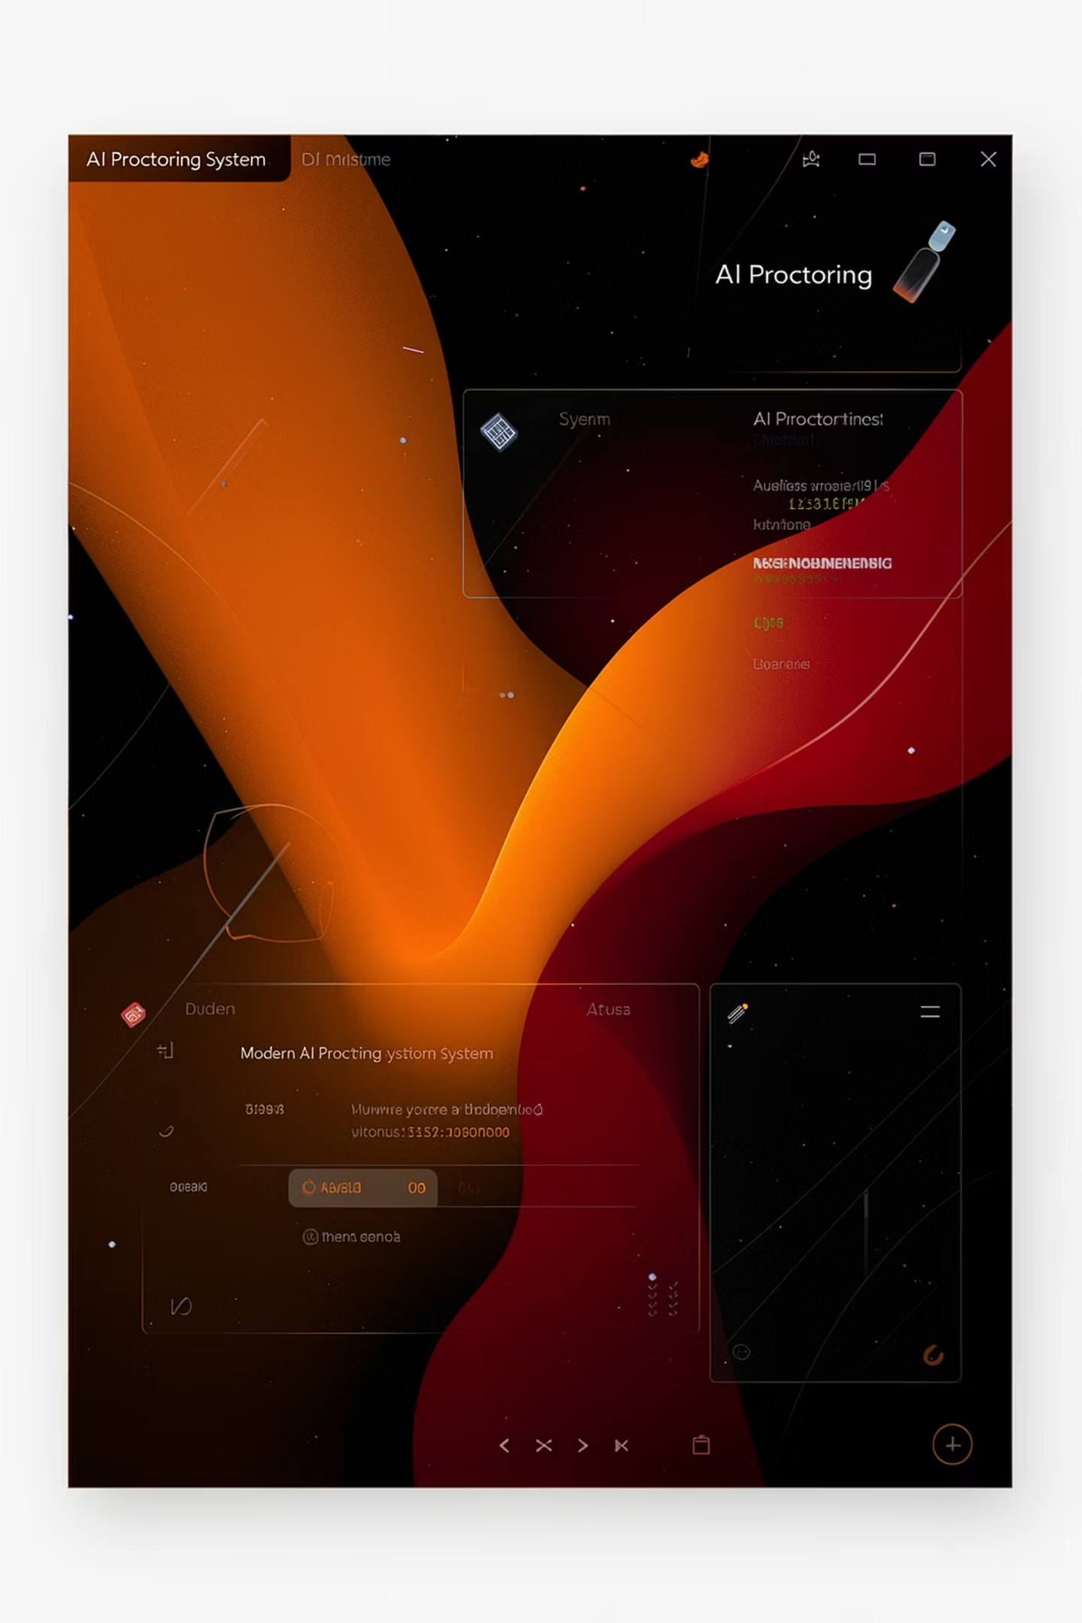
ProctoEase
AI-Based Online Exam Proctoring System
Development Progress Report
Presenting a comprehensive overview of the secure online examination platform with real-time AI monitoring capabilities.

Slide 2




Project Overview
An intelligent, secure online examination platform leveraging AI-powered monitoring to prevent academic dishonesty while maintaining candidate experience.
AI-Powered Monitoring
Anti-Cheating Measures
Real-time proctoring using advanced computer vision and behavioral analysis
Multi-layered security protocols including tab detection and keyboard blocking
Candidate Experience
Scalable Architecture
Intuitive interface with responsive design and minimal friction during exams
Cloud-native design supporting thousands of concurrent examinees

Slide 3

Development Progress: Work Completed
Frontend Stack
Backend Foundation
JWT-based authentication system
Admin and candidate dashboards
Complete exam flow implementation
Real-time proctoring UI interface
SEO-optimized landing page
Structured error handling hierarchy
Comprehensive logging system
Docker container optimization
AI proctoring event foundation
WebSocket integration

Slide 4
Frontend Architecture
Modern React-based stack with TypeScript for type safety and maintainability.
01
02
03
React 18 + TypeScript
React Router v6
React Query
Latest React features with static type checking
Client-side navigation with protected routes
Efficient data fetching and state management
04
05
Tailwind CSS + shadcn/ui
Axios Interceptors
Component library with utility-first styling
HTTP client with JWT auto-refresh logic

Slide 5
Frontend Features in Detail
1
2
3
Landing Page Excellence
Exam Flow Engine
Proctoring Interface
99% uptime guarantee with <2s verification. Fully responsive design with performance metrics display.
Integrated timer, question navigation, auto-submit on completion, and session persistence.
Live webcam preview, real-time violation counter, and status indicators for examinees.
4
5
Security Layers
UX Enhancements
Tab switch detection, keyboard shortcut blocking, and full-screen enforcement throughout exams.
Skeleton loaders, error boundary protection, SEO meta tags, and accessibility compliance.

Slide 6

Backend Phase 4: System Hardening
14
3
100%
Custom Exception Classes
Error Handlers
HTTP Exception Coverage
Domain, validation, and fallback handlers
Structured inheritance hierarchy for error handling
Production-ready API responses
Implemented comprehensive error handling system with 14 custom exception classes, global error handlers producing consistent API responses, and detailed validation error reporting with field-specific messages (HTTP 422).

Slide 7
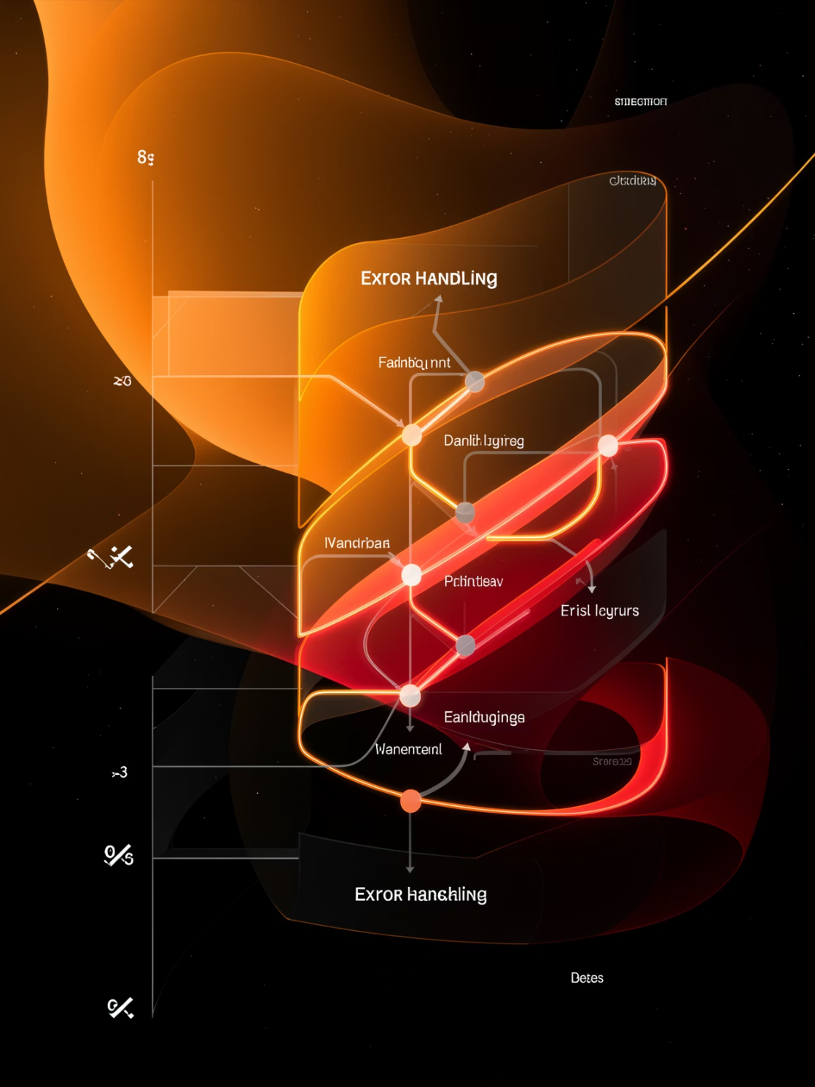
Error Handling Architecture
Exception Hierarchy
Base: AppException (abstract)
BadRequestException (400)
UnauthorizedException (401)
ForbiddenException (403)
NotFoundException (404)
ConflictException (409)
Common Exceptions
InvalidTokenException
ExamNotFoundException
DuplicateEmailException
RateLimitExceededException

Slide 8





Logging & Deployment Optimization
Structured Logging
JSON format in production, human-readable in development with timestamp, level, and message fields.
Request Tracking
Unique request_id for each HTTP request enabling complete request lifecycle tracing across services.
Tenant Isolation
tenant_id tracking for multi-tenant SaaS architecture ensuring data separation between organizations.
Container Security
Multi-stage Docker builds, non-root user execution, health checks, and minimal base images.

Slide 9




Backend Phase 5: AI Proctoring System
WebSocket Monitoring
REST APIs
Persistent connections for real-time event streaming with JWT authentication
Exam creation, event management, and violation tracking endpoints
Event Classifier
Data Models
Rule-based engine categorizing user behavior into violation types
ProctoringEvent (8 violation types) and Question (4 types) with JSON configuration

Slide 10






Proctoring Workflow
Capture
Browser accesses webcam and monitors user activity
Authenticate
WebSocket connection established with JWT token
Classify
Events categorized: tab_switch, keyboard_block, no_face, fullscreen_exit
Store
Events logged in PostgreSQL using JSONB for flexible schema
Update
Violation counter increments in real-time for admin monitoring
Analyze
Future AI risk scoring based on violation patterns

